Slide 1
Ultra-energy-efficient Silicon Photonic Modulators Driven by Transparent Conductive Oxides
Presenter: Erwen Li

Slide 2
Outline
2
Research Background
Motivation to ultra-energy-efficient optical interconnects
Review of silicon photonics
Heterogeneous Integration
Transparent Conductive Oxides (TCOs) for Electro-optical (E-O) Modulators
Introduction to transparent conductive oxides (TCOs)
Review of TCO-driven E-O devices
Overview of My Works
High-speed Ultra-energy-efficient Si-TCO Photonic Crystal (PC) Nanocavity Modulator
TCO-Gated Silicon Microring Resonator
Conclusions
Notes:
First, I will introduce the research background and motivation
Next, I will brief review the development of TCO for EO applications
After that, I will talk about three devices I have worked on

Slide 3
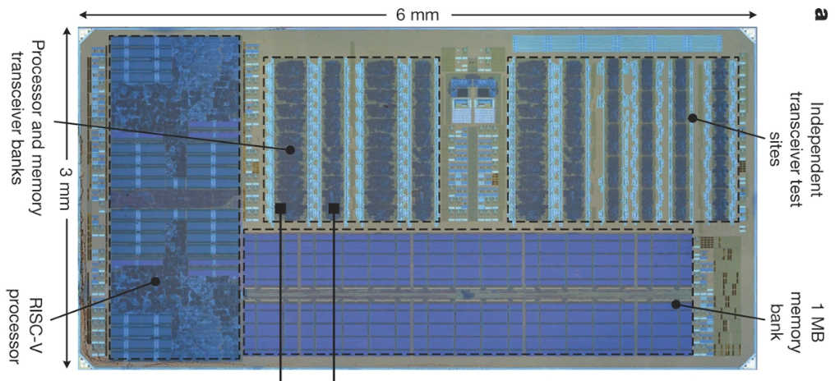
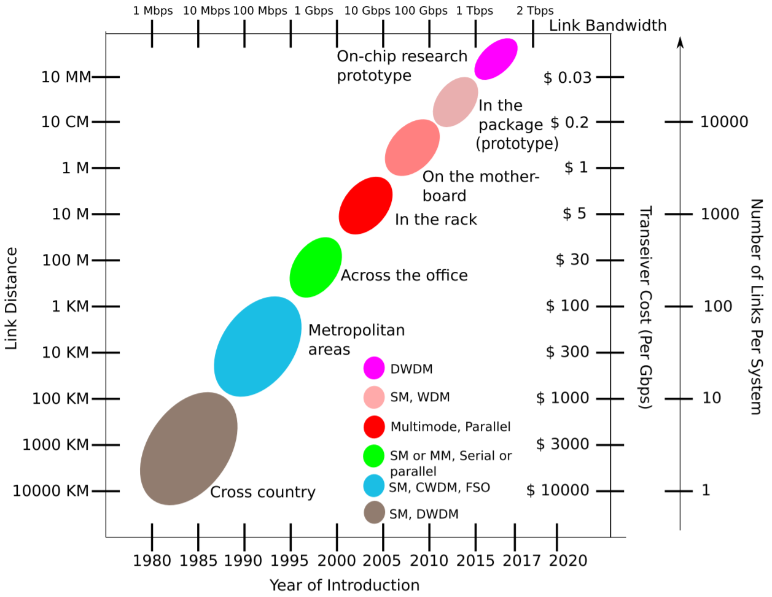
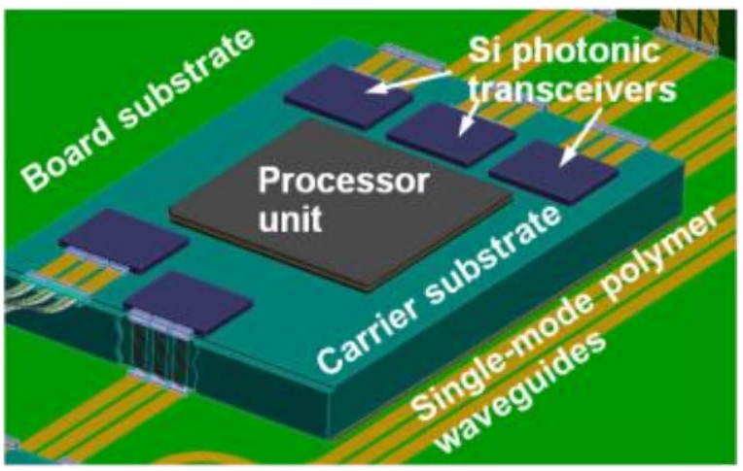
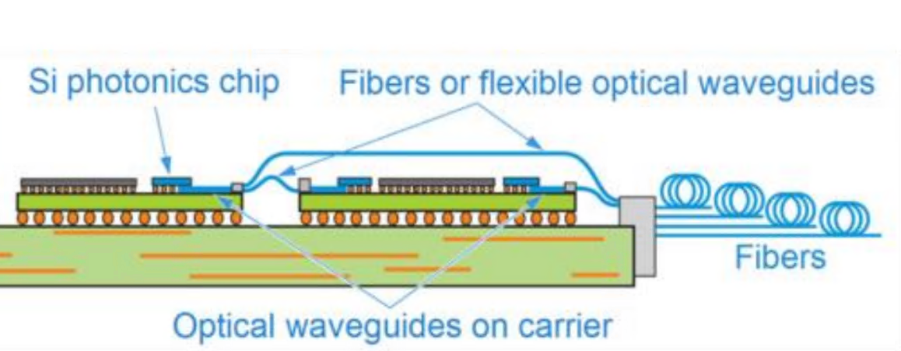
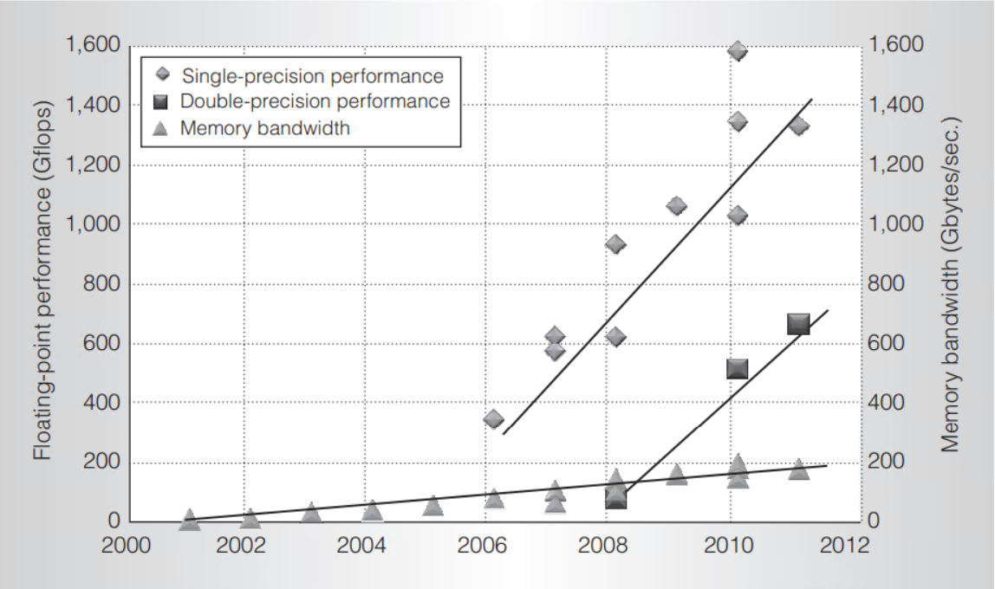
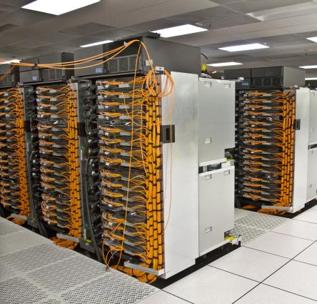
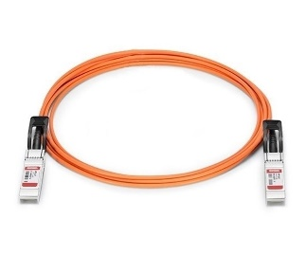
Motivation to ultra-energy-efficient optical interconnects
3
Monolithic
Core-to-core
Evolution of optical communication
(Sun, C., et al, Nature (2015))
Co-packaging SiP
Chip-to-chip
GPU processor and memory-system performance trends
Processing performance
(La Porta, A., et al. 2015 ECTC)
AOC
rack-to-rack
(Cisco SFP-10G-AOC3M)
(IBM Sequoia 2012)
Interconnect bandwidth
(Bashir, et al. ACM Computing Surveys (CSUR) 51.6 (2019))
(Keckler, Stephen W., et al. IEEE micro 31.5 (2011))
Advantages of optical interconnects compared with electrical interconnects:
Bandwidth density, Signal latency, Power efficiency, Cost
The growth of processing power is much faster than the growth of interconnects bandwidth.
Notes:
Optical interconnects has become an universal solution for data communication due to its advantages in bandwidth density, latency, energy and cost efficiency, comparing with its electrical counterparts.
Today, the optical interconnects has take the form of pluggable optical modulator for data communication between rack to rack in data centers and supercomputers.
However, if we look at the developing of parallel computing system, the growth of electrical interconnects bandwidth is much slower than the processing performance, which becomes the bottle neck for the scaling of computation system. This forms a driving force to push the optical interconnects into the rack for connection between chip-to-chip and even on a single chip between core-to-core.

Slide 4
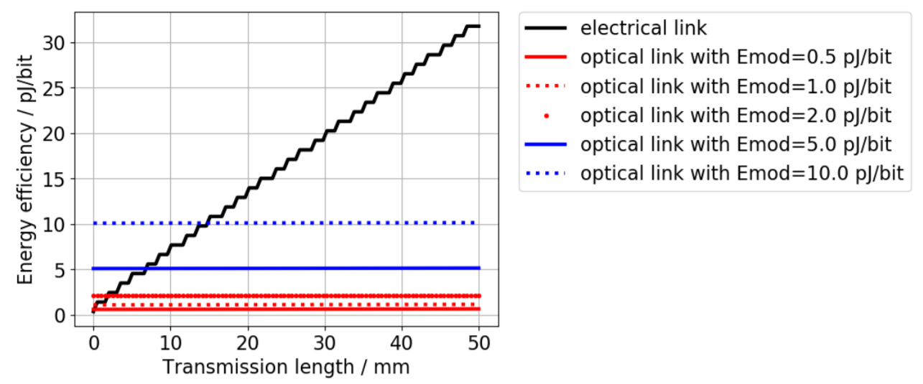
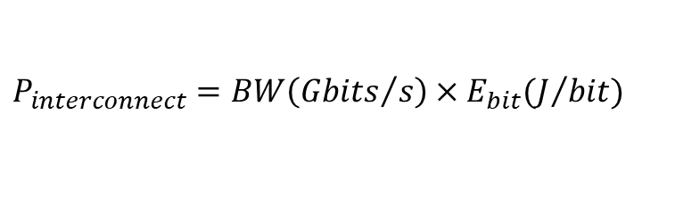
Motivation to ultra-energy-efficient optical interconnects
4
Interconnects are limited by both the bandwidth density and energy efficiency
Evolution of optical communication
Energy efficiency of example electrical and optical links
(Thraskias, Christos A., et al. IEEE Communications Surveys & Tutorials 20.4 (2018))
Operation | Energy per bit
Communicating off chip | 1~20 pJ
Communicating across chip | 600 fJ
Inter-chip
Intra-chip/on-chip
(Miller, David AB. J. Lightwave Technol. 35.3 (2017))
Bandwidth
Energy efficiency
$$P_{interconnect}=BW\left({Gbits}/s\right)×E_{bit}(J/{bit})$$
(Bashir, et al. ACM Computing Surveys (CSUR) 51.6 (2019))
On chip data movement will exceed 1 petabits/s (10¹⁵ bits/s) in the next decade;
Current interconnect energy budget a few Watts;
Ultra-energy-efficiency optical interconnect of attojoule per bit (<10⁻¹⁵ J/bit) has been outlined.
Notes:
However, interconnects are not only limited by the bandwidth density, but also the energy efficiency.
Unlike electrical interconnects, the energy efficiency scales with the distance. The energy efficiency of optical interconnects is mainly dependent on its modulation method.
In order to make sense to replace electrical interconnect in shorter distance, there are some milestones in energy efficiency to achieve for the optical interconnects
Besides, with the vision of chip data movement exceeding 1petabits/s, attojoule per bit energy efficiency has been outlined in order keep the current inter connect energy budget

Slide 5
Review of silicon photonics
5
Bandwidth density
Cost effectiveness
Energy efficiency
CMOS compatibility
Notes:
In the past two decades, the development of silicon photonics has offered us a platform to achieve high bandwidth, energy efficiency and cost effectiveness by taking advantage of the CMOS fabrication.

Slide 6
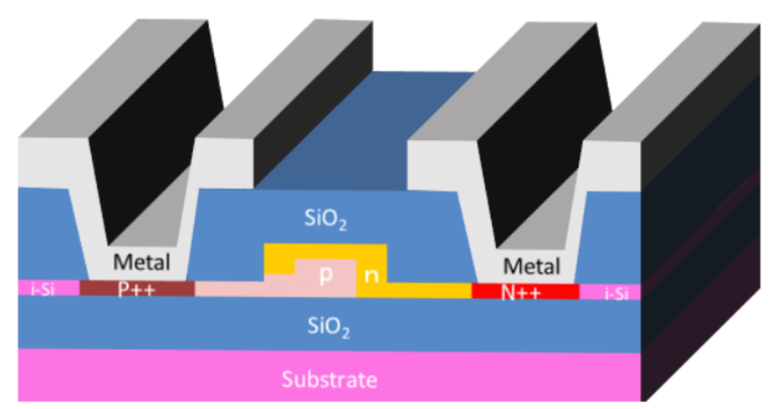
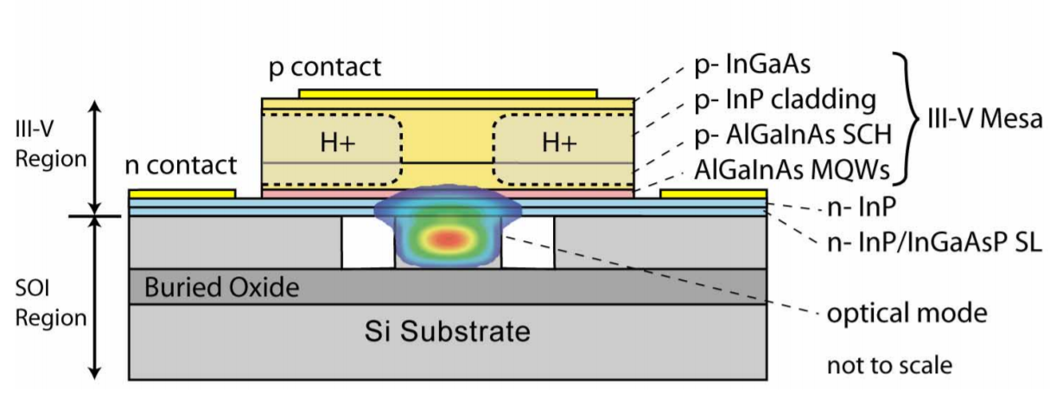
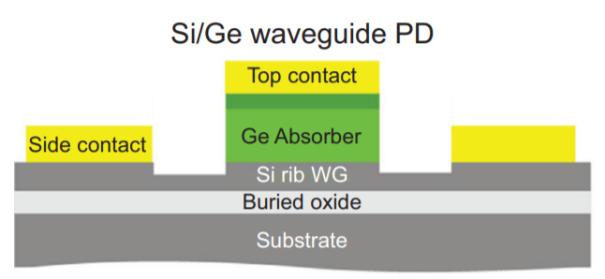
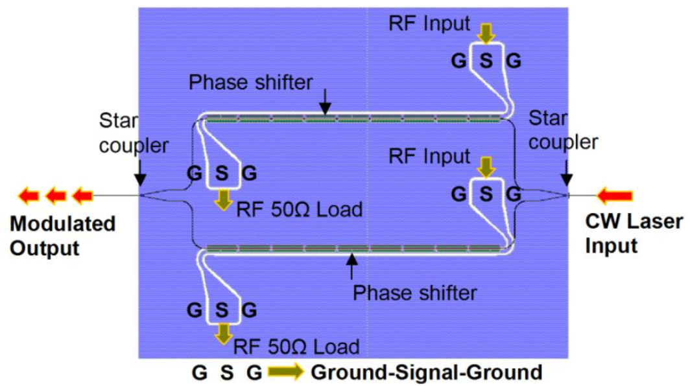
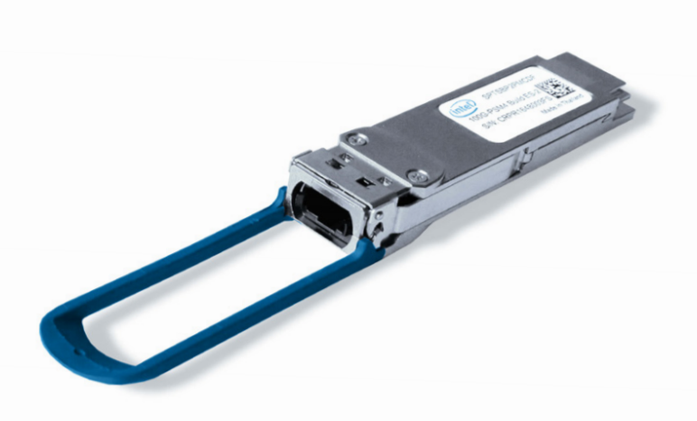
Review of silicon photonics
6
Si MZI modulator
Gardes, F. Y., et al. "40 Gb/s silicon photonics modulator for TE and TM polarisations." Optics express 19.12 (2011): 11804-11814.
Hybrid III-V/Si laser
Si/Ge photodetector
(Fang, Alexander W., et al. Optics express 14.20 (2006))
(Piels, Molly, and John E. Bowers. Photodetectors. Woodhead Publishing, 2016)
Conventional Si modulator based on Mach-Zehnder interferometer (MZI)
100G PSM4 QSFP28
Optical Transceiver
(Gardes, F. Y., et al. Optics express 19.12 (2011))
Pros:
Mature technique
Fast speed (50Gb/s)
Linear response
Broadband operation
Cons:
Large size: hundreds of µm~mm
Large energy consumption: ~pJ/bit
Not suitable for on-chip interconnects
Max power: 3.5W
Energy efficiency: 35pJ/bit
Notes:
With the technology to fabricate integrated laser, modulator, photo detector become mature.
Today, SI photonic has been commercialized for today’s 100G optical transiver
Although the convention MZI has the advantages of
However

Slide 7
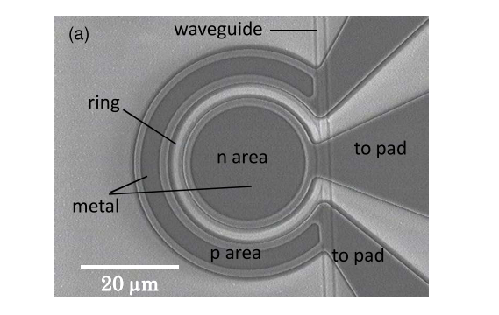
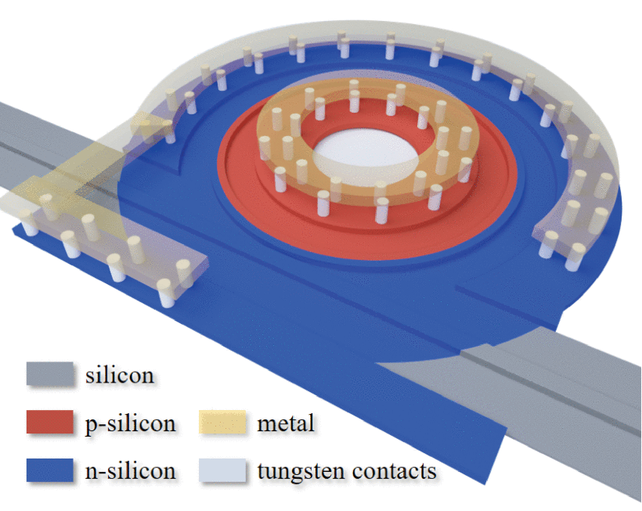
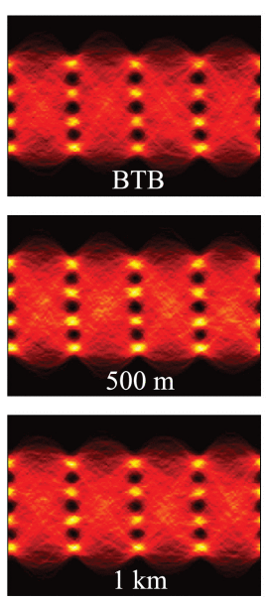
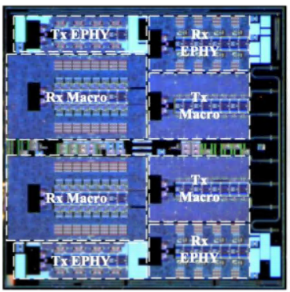
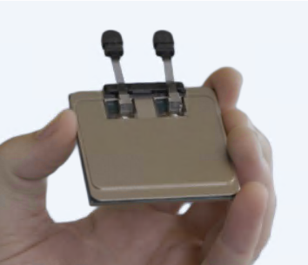
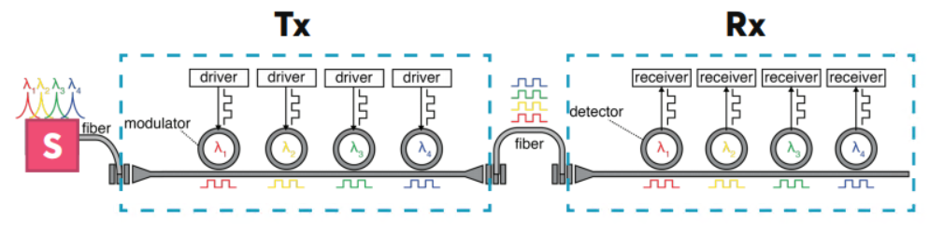
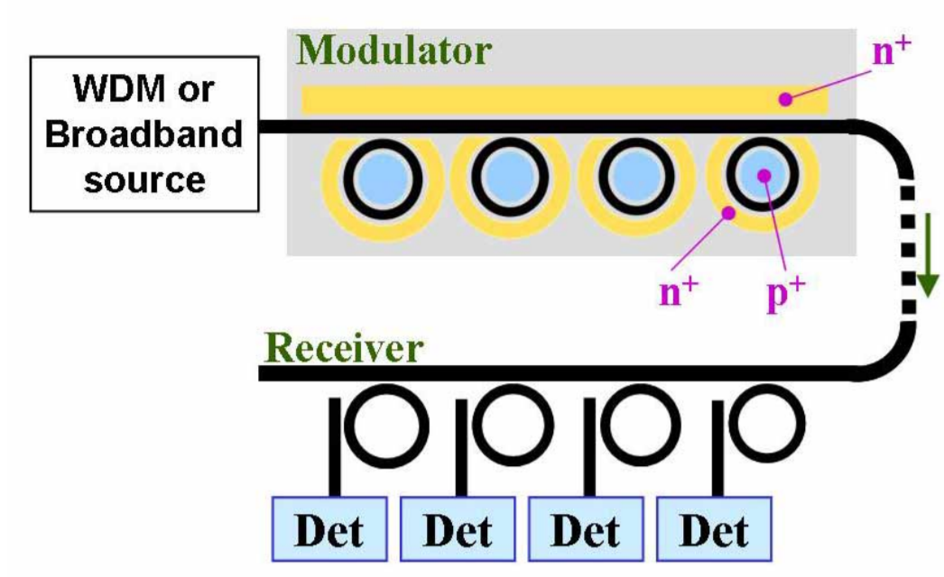
Review of silicon photonics
7
PAM4
Optical I/O chiplets
Si modulator based on micro-resonator
160Gb/s
(Tong, Yeyu, et Al. IEEE Photonics Technology Letters (2019))
(Dong, Po, et al., Optics express (2009))
Micro-resonators
Microring, microdisk, photonic crystal (PC) nanocavity
Pros:
Compact size: ~tens of micron
Low energy consumption: fJ/bit~ 100fJ/bit
Massive integration
Cons:
Small optical bandwidth
Require active wavelength control
Photon lifetime limited operation speed
Compact wavelength division multiplexing (WDM)
8 λ channels × 25Gb/s × 10 optical ports = 2Tb/s
Ayar labs: TeraPHY
(Meade, Roy, et al. 2019 OFC IEEE, 2019)
(Xu, Q., et al, Optics express, (2006))
Notes:
In the recent years people are paying more attention to the resonator based modulator
By taking advantage of the high Q resonator,
And recently, an optical I/O chiplet based on MRM has been reported
However,
It has two main drawbacks

Slide 8
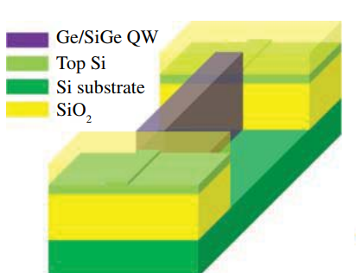
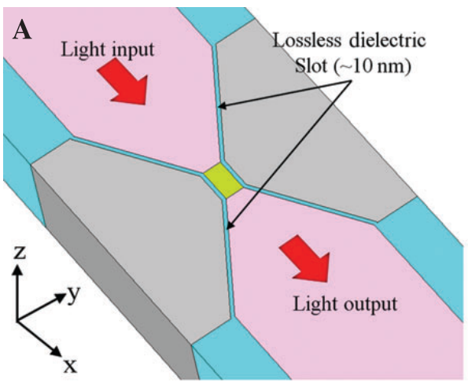
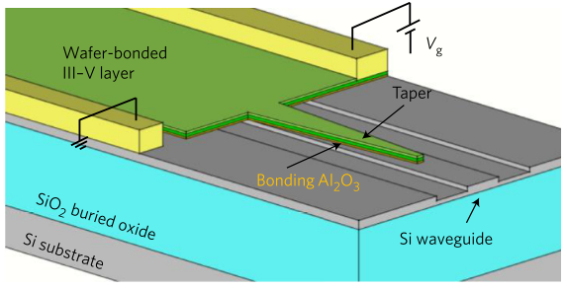
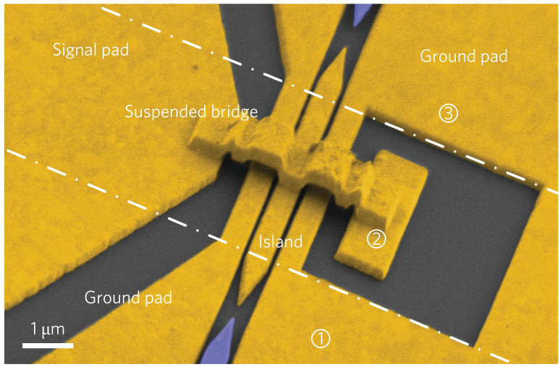
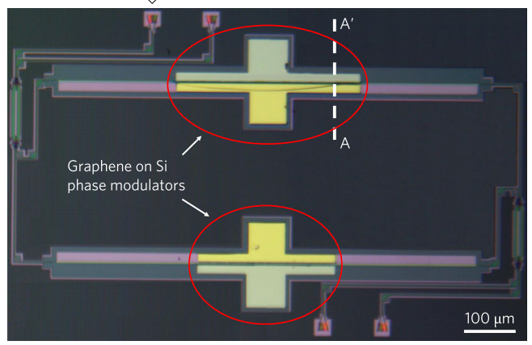
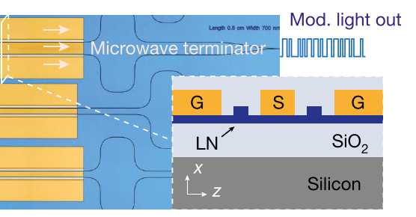
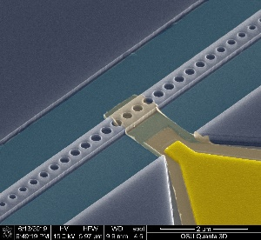
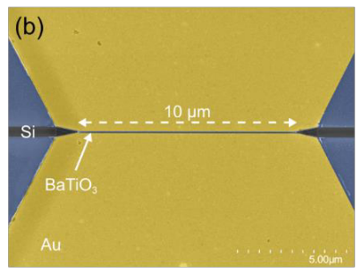
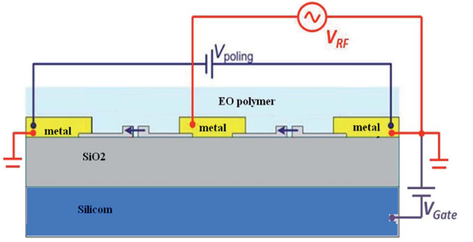
Heterogeneous Integration
8
Ren, S., et al. GFP 2011
Silicon photonics
Ge
III-V
plasmonics
LiNbO₃
Graphene/ 2D materials
E-O polymer
Ferroelectric matericals
TCO
Phase change materials
Han, Jae-Hoon, et al. Nature Photonics 11.8 (2017)
Ooi, Kelvin JA, et al. Nanophotonics 2.1 (2013)
Haffner, Christian, et al. Nature Photonics 9.8 (2015)
Sorianello, V., et al. Nature Photonics 12.1 (2018)
Wang, Cheng, et al. Nature 562.7725 (2018)
The performance of Si modulators are limited by the weak plasma E-O effect of Si.
Messner, Andreas, et al. OFC 2017.
Liu, Jialei, et al. Rsc Advances 5.21 (2015)

Slide 9
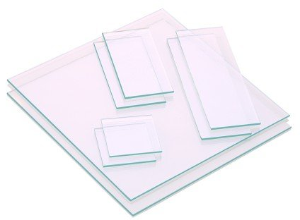
Introduction to transparent conductive oxides (TCOs)
9
Transparent conductive oxides
Highly doped wide bandgap oxide semiconductor
Indium tin oxide (ITO), Aluminum zinc oxide (AZO), Cadmium oxide (CdO)
High conductivity and low optical loss
Varieties of applications in research and industry (display, photovoltaic)
Typical carrier concentration: 10¹⁹~10²¹ cm-3
Strong plasma dispersion
Unit change of refractive index
Epsilon-near-zero (ENZ) materials at telecom wavelength range
Simple fabrication process
(https://www.techinstro.com)

Slide 10
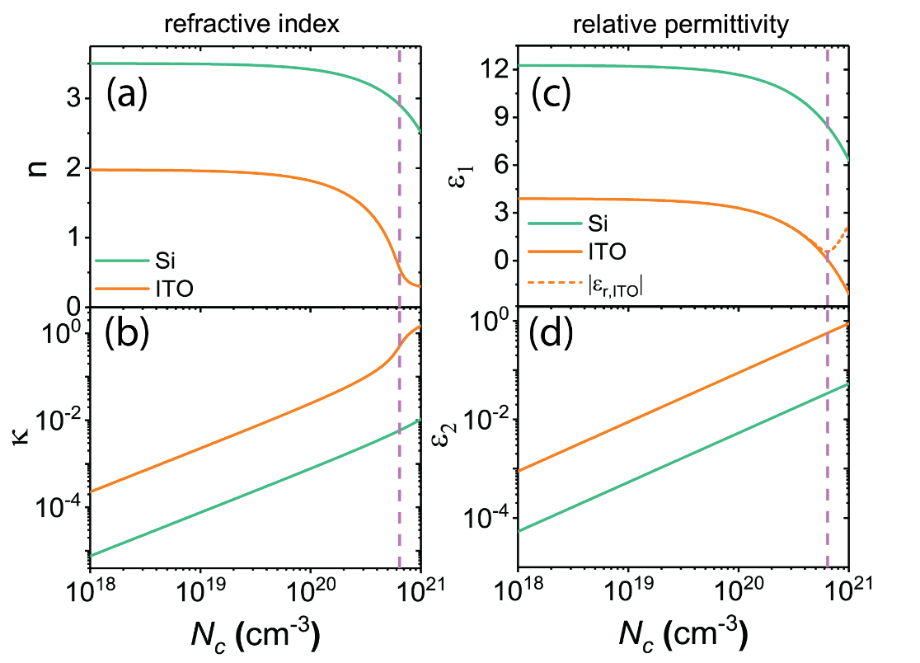












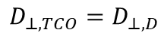

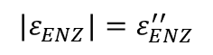


Optical properties of TCOs
10
Comparison of Si and ITO optical properties @ 1.55µm
Drude model
$$ε_{r}=ε_{∞}−\frac{ω_{p}^{2}}{\left.ω(ω+iΓ\right)}$$
Relative permittivity:
ENZ
$$ω_{p}^{2}=\frac{N_{c}q^{2}}{ε_{0}m^{∗}}$$
Plasma frequency:
$$Γ=\frac{q}{μm^{∗}}$$
Collision frequency:
High frequency permittivity:
plasma collision frequency:
Free carrier concentration:
Effective mass:
Carrier mobility:
$$ε_{∞}$$
$$Γ$$
$$N_{c}$$
$$m^{∗}$$
$$μ$$
ENZ induced light confinement and absorption enhancement
Dissipation power density
Continuity of electrical displacement
$$P_{d}=\frac{1}{2}ωε_{TCO}^{′′}ε_{0}E_{TCO}^{2}∝\frac{ε_{TCO}^{′′}}{{|ε_{TCO}|}^{2}}$$
Low loss material absorbs more light!
Dielectric
$$D_{⊥,D}$$
$$E_{⊥,D}$$
$$D_{⊥,TCO}=D_{⊥,D}$$
$$E_{⊥,TCO}$$
ENZ condition
ENZ-TCO
$$D_{⊥,TCO}$$
$$E_{⊥,TCO}=\frac{{|ε}_{D}|}{{|ε}_{TCO}|}E_{⊥,D}$$
$$P_{d}∝\frac{ε_{ENZ}^{′′}}{{|ε_{ENZ}|}^{2}}=\frac{1}{ε_{ENZ}^{′′}}$$
$$|ε_{ENZ}|=ε_{ENZ}^{′′}$$

Slide 11
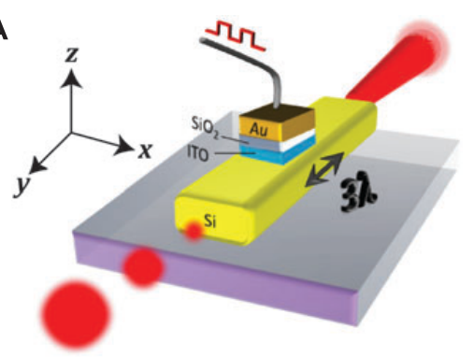
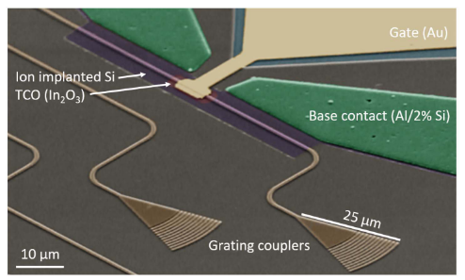








Review of TCO-driven E-O devices
11
Electro-absorption (EA) modulator driven by ENZ TCO
Hybrid plasmonic-Si waveguide
Plasmonic slot waveguide
(Sorger, Volker J., et al. Nanophotonics (2012))
(Wood, Michael G., et al. Optica (2018))
(Zhou, Bokun, et al. J. Lightwave Technol. (2020))
(Lee, Ho W., et al. Nano letters 14.11 (2014))
(Gao, Qian, et al. Photonics Research 6.4 (2018))
Extinction Ratio (ER): 1dB/µm
ER: 1.6~2.5dB/µm
2.5Gb/s data rate
(Our group’s work)
ER: 0.63 dB/µm
4.5Gb/s data rate
Potential speed: 15GHz
ER: 2.7dB/µm
(Our group’s work)
Integration with Si WG
ER: 1.5dB/µm
40MHz
Potential speed: 300GHz

Slide 12










Review of TCO-driven E-O devices
12
Compact phase shifter
Tunable meta-surface
(Huang, Yao-Wei, et alNano letters 16.9 (2016))
(Kafaie Shirmanesh, Ghazaleh, et al. Nano letters 18.5 (2018))
(Amin, Rubab, et al. APL Photonics 3.12 (2018))
(Amin, Rubab, et al. Optica 7.4 (2020))
(Park, Junghyun, et al. Scientific reports 5 (2015))
Kafaie Shirmanesh, Ghazaleh, et al. ACS nano (2020).
V_{π}L: 0.52 V∙mm
V_{π}L: 95 V∙µm
Absorber
15% change in reflection
Beam steering
Tunable lens
Phase tuning range: ~300°

Slide 13





13
First EA modulator driven ENZ TCO
(Wood, Michael G., et al. Optica (2018))
First demonstration of high-speed operation
EA modulator
Our group’s work
(Sorger, Volker J., et al. Nanophotonics (2012))
(Zhou, Bokun, et al. J. Lightwave Technol. (2020))
Our group’s work
(Gao, Qian, et al. Photonics Research 6.4 (2018))
2010
(Lee, Ho W., et al. Nano letters 14.11 (2014))
2020
Phase shifter
(Amin, Rubab, et al. APL Photonics 3.12 (2018))
(Amin, Rubab, et al. Optica 7.4 (2020))
First demonstration of TCO’s large index tunability
Tunable metasurface
(Park, Junghyun, et al. Scientific reports 5 (2015))
(Huang, Yao-Wei, et alNano letters 16.9 (2016))
(Kafaie Shirmanesh, Ghazaleh, et al. Nano letters 18.5 (2018))
Kafaie Shirmanesh, Ghazaleh, et al. ACS nano (2020).
Notes:
This slides shows the overview of development TCO-driven E-O devices.

Slide 14














Overview of My Works
Hybrid Si-TCO PC nanocavity modulator
14
Ultra-energy-efficient modulator
Electrically tunable subwavelength grating using TCO
Surface plasmon polaritons (SPPs) coupled with guided-mode resonance (GMR).
Simulation
All-optical Switch (AOS)
Low voltage
low energy consumption
Proof-of-concept
High-speed operation
TCO-gated Si micro-resonators
ENZ effect
Experiment results
2017
2018
2019
2020
Wavelength control
Operation speed
Electrically tunable subwavelength grating
TCO-gated Si microring resonator

Slide 15
15
High-speed ultra-energy-efficient Si-TCO PC Nanocavity Modulator
Device principle and previous results
Electrical design for high-speed E-O modulation
Experimental demonstration
Analysis of free carrier-optical mode overlapping
Towards atto-joule per bit energy efficiency
Summary
TCO-Gated Silicon Microring Resonator
TCO-gated silicon microring filter (Extreme tunability)
TCO-gated silicon microring modulator (High speed)
Summary
Ultra-fast Femto-joule All-optical Switching (AOS) using high mobility TCO
Nonlinear optical effect in ENZ TCO
Principle of the AOS driven by high mobility TCO
Transient response of the AOS device
Comparison with other on-chip AOS devices
Summary

Slide 16






Carrier-driven silicon modulators based on micro-resonators
16
Electrical input
EO modulator: a device that converts electrical signals into coded optical signals
Modify free carrier distribution
Capacitor design
(Electrical configuration)
Change material optical property
Active material
Detune resonance frequency
$$λ_{res}=\frac{n_{eff}L}{m}$$
Resonator design
$n_{eff}$: effective refractive index of the resonator
$L$: resonator dimension
$m$: mode order
Optical output
Notes:
EO modulator: a device that converts electronical signals into coded optical signals
While a carrier-driven Res based M, consists of a electrical capacitor physically overlapped with an optical resonator
The operation consists of 3 steps
Each step corresponds to three main factors factor for the modulator design

Slide 17








Energy efficiency of a resonator-based modulator
17
Energy efficiency of resonator-based Si modulator @ 1.55µm
Cavity perturbation theory
$$∆ω=\frac{−\frac{ω}{2}\int{∆ε{\left|E\right|}^{2}dv}}{\int{ε{\left|E\right|}^{2}dv}}$$
Increase Purcell factor
Use more effective material
Capacitance density
Wavelength tunablity:
$$\frac{∆λ}{λ}=\frac{∆ω}{ω}=\frac{αKQ_{tot}}{2V_{m}}=(\frac{1}{2}K∙\frac{αC}{V_{m}})∙V$$
Increase total capacitance
Energy per bit:
$$E_{bit}=\frac{1}{4}CV^{2}=\frac{1}{4}\frac{{\left({Q_{tot}}/2\right)}^{2}}{C}$$
$=\frac{9}{64π^{4}}{\left({\left(\frac{λ}{n}\right)}^{3}\frac{1}{{gF}_{p}}\right)}^{2}\frac{{\left(qN_{ENZ}\right)}^{2}}{α^{2}C}∝\frac{1}{K}∙\frac{1}{{(gF_{p)}}^{2}}∙\frac{1}{α^{2}C}$
Total capacitance
Carrier dispersion coefficient:
Overlapping factor:
$$K=−\frac{∂{Δε}/ε}{∂ΔN_{c}q}=\frac{q}{ε_{0}ε_{r}m^{∗}ω^{2}}=\frac{1}{qN_{ENZ}}$$
$$α=\frac{\int{ε∆N_{c}q{\left|E\right|}^{2}dv}}{Q_{c}max⁡(ε{\left|E\right|}^{2})}$$
Capacitor design
PN junction
MOS capacitor
Active material
Si
III-V
TCO
graphene
Optical resonator
Micro-ring
Micro-disk
PC nanocavity
Purcell factor:
$$F_{p}=\frac{3}{4π^{2}}{\left(\frac{λ}{n}\right)}^{3}\frac{Q}{V_{m}}$$
$Q$: Q-factor
$V_{m}$: mode volume
Notes:
We derive the dependence of two important performance merit on these three factors
Based on this
We can use this to serve as the guideline to evaluate the modulator design and direct the optimization.

Slide 18





Principle of the Si-TCO PC nanocavity modulator
18
ITO/oxide/p-Si MOS capacitor
Ultra-small active volume: 0.02~0.06 λ³
Photonic crystal nanocavity
Photonic crystal mirror segment
(distributed Bragg reflector)
Electrons accumulate at ITO/oxide interface
Holes accumulate at Si/oxide interface
Both contribute to E-O modulation

Slide 19


Principle of the Si-TCO PC nanocavity modulator
19
ITO/oxide/p-Si MOS capacitor
Ultra-small active volume: 0.02~0.06 λ³
Cavity resonance tuning
Optical absorption
$$Δε_{ITO}=Δε_{TCO}^{′}+iΔε_{TCO}^{′′}$$
$$Δε_{Si}=Δε_{Si}^{′}+iΔε_{Si}^{′′}$$
Real part of permittivity variation
Imaginary part of permittivity variation
Electrons accumulate at ITO/oxide interface
Holes accumulate at Si/oxide interface
Both contribute to E-O modulation

Slide 20





Advantages of the Si-TCO PC nanocavity modulator
20
Transparent conductive oxides
PC nanocavity
MOS capacitor
High conductivity and low optical loss
Perfect gate material for resonator
Little perturbation to the optical field
PC nanocavity
Strong plasma dispersion
Small mode volume
Large Purcell factor with moderate Q factor of ~5000
$$\frac{C_{MOS}}{A}≈\frac{ε_{0}ε_{ox}}{t_{ox}}$$
Capacitance density can be controlled by the permittivity and thickness of gate insulator
High-k dielectric
Large capacitance density
3D MOS
Large $C/V_{m}$ ratio
3D MOS
Carrier accumulation

Slide 21





Review of previous demonstrations
21
Proof-of-concept
Low driving voltage, low energy consumption
1nm
16dB
20nm ITO/20nm SiO₂/p-Si MOS
Insertion loss: -0.5dB
Q factor: 1000
Wavelength tunability: 30pm/V
Wavelength tuning range: 0.57nm
Max ER: 5.6dB
3dB driving voltage: 12V
Capacitance: 1.28 fF
Energy consumption: 46 fJ/bit
20nm In₂O₃/10nm HfO₂/p-Si MOS
Insertion loss: -6dB
Q factor: 3700
Wavelength tunability: 250pm/V
Wavelength tuning range: 1nm
Max ER: 16dB
3dB driving voltage: 1V
Capacitance: 13 fF
Energy consumption: 3fJ/bit
Notes:
First, we fabricate a proof of concept device using SiO2 as gate oxide
Next, we replace the gate insulator with high k HfO2,
Taking advantage of the large capacitance density, we achieve,
So the next step is to demonstrate high speed operation

Slide 22



Electrical design for high-speed E-O modulation
22
Previous design
New design
To improve RC limited bandwidth:
Partially etched silicon slab
Reduce distance between metal contact and active region
Silicon doping are carefully designed
Notes:
First, par, allow wider path for current to flow to the active region
Next, reduce conduction path

Slide 23







Electrical design for high-speed E-O modulation
23
Illustration of doping profile
HFSS simulation
$$R_{p−}$$
$$R_{p+}$$
$$R_{p++}$$
$$R_{ITO}$$
Sheet resistance
Aspect ratio
 | p- | p+ | p++ | ITO | R_{r}
dopant density (cm⁻³) | 1×10¹⁷ | 5×10¹⁸ | 1×10²⁰ | 2×10²⁰ | \
Sheet resistance (Ω/square) | 10.7k (200nm) | 2.9k (50nm) | 253 (50nm) | 625 (20nm) | \
Aspect ratio (3 perods) | 0.08 | 0.18 | 0.9 | 0.892 | \
R (Ω) (3 periods) | 856 | 530 | 228 | 558 | 78
Aspect ratio (1 period) | 0.08 | 0.22 | 0.55 | 3.19 | \
R (Ω) (1 period) | 856 | 638 | 139 | 1994 | 93
HFSS: simulate S11 parameters
ADS: fit equivalent circuit model
Extract parameters
Expected performance
1 period
R: 3765 Ω
C: 6.1 fF
Speed: 7GHz
3 periods
R: 2250 Ω
C: 18.3 fF
Speed: 3.9GHz
Notes:
1614 1633
To have a quantitative expectation of the speed, we systematically investigate the relationship between the speed and semiconductor conduction path

Slide 24


Experimental results: Device images and DC performance
24
DC performance
Device images
20nm ITO/16nm HfO₂/p-Si MOS
Q factor: 5,600
Limited by Silicon and ITO doping level (~9,500 after EBL and RIE)
Tuning efficieny: 71pm/V
3dB driving voltage: <2V
Device length: 14.8µm
Footprint: 30µm²

Slide 25




Experimental results: high speed modulation
25
1.25GHz AC modulation
Eye diagrams
Testing setup schematic
Direct proof of TCO gate’s capability for high speed modulation
Rise time: ~0.135ns
3dB bandwidth: 2.5GHz
Eye diagrams: up to 5Gb/s
Signal output from generator: 1 Vpp
Voltage on DUT: 2 Vpp

Slide 26



Optimization for higher bandwidth
26
Speed analysis
Capacitance: 18.3 fF
Series resistance: 3.9 kΩ
$R_{Si}$: ~3.3 kΩ
P++ silicon sheet resistance ~1100Ω/square
$R_{ITO}$: ~0.6 kΩ
ITO sheet resistance 700Ω/square
Future optimization
Node-matched Si doping
Put p++ closer to active region
High mobility TCO, such ITiO
$μ_{ITO}=20 {cm}^{2}/(Vs)$
$μ_{ITiO}=80 {cm}^{2}/(Vs)$
Expected performance (HFSS)
Series resistance: 852Ω
Capacitance: 6.1 fF (1 period)
RC bandwidth: 30 GHz
3dB bandwidth: 23.5 GHz
Notes:
Rsi estimated from the resistance from two silicon ground electrodes
Good match with our simulation
Standing wave

Slide 27





Analysis of free carrier-optical mode overlapping
27
Capacitance: 18.3 fF
Driving voltage: 2V
Energy efficiency: 18.3 fJ/bit
Overlapping factor estimation:
$$α=\frac{Δλ}{V}\frac{V_{m}}{λ⋅K⋅C}$$
Overlapping factor:
$$α=\frac{\int{ε∆N_{c}q{\left|E\right|}^{2}dv}}{Q_{c}max⁡(ε{\left|E\right|}^{2})}$$
This device: 1.79%
under etching in the air hole
Previous device (250pm/V): 7.43%
Match well with the calculation
Expected performance
Overlapping factor:
1.79% -> 7.2%
Wavelength tunability:
71 pm/V -> 285 pm/V
Driving voltage:
2V -> 0.5V
Energy consumption:
18.3 fJ/bit -> 1.14 fJ/bit
Red/yellow: optical mode (FDTD)
Blue: accumulated carriers (Silvaco)
Notes:
Previously, We have discussed on the material, resonator, and capacitor. Here, in order to investigate on the last important factor overlapping factor.
It describes how the carrier distribution perturbation is overlapped the optical energy.
This figure shows the calculated overlapping factor versus the position of the active TCO-Si MOS capacitor by assuming the MOS capacitor covering one period of the PC nanocavity
Crosssection at the in the center of the waveguide
Subwavelength bridge

Slide 28



Towards atto-joule per bit energy efficiency
28
Comparison with reported devices
Cross point: reported energy efficiency
Solid point: Calculated energy efficiency based on Purcell factor, capacitance assuming perfect overlapping
Dashed line: indicating the overlapping factor
Proposed design
Previous device
[1]
[2]
[3]
[5]
[4]
Expected performance
Overlapping factor:
22%
Capacitance:
6 fF
Driving voltage:
0.5V
Energy consumption:
375 aJ/bit
M. R. Watts, W. A. Zortman, D. C. Trotter, R. W. Young, and A. L. Lentine, Opt. Express, vol. 19, no. 22, p. 21989, Oct. 2011.
E. Timurdogan, C. M. Sorace-Agaskar, J. Sun, E. Shah Hosseini, A. Biberman, and M. R. Watts, Nat. Commun., vol. 5, no. 1, p. 4008, Dec. 2014.
P. Dong et al., Opt. Express, vol. 17, no. 25, p. 22484, Dec. 2009.
J. Van Campenhout et al., in Optical Fiber Communication Conference, 2012, p. OM2E.4.
X. Xiao et al., Opt. Express, vol. 20, no. 3, p. 2507, Jan. 2012.
Ref | Capacitor /resonator type | Q-factor | Vm (${(λ/n_{Si})}^{3}$) | gFp | C (fF) | α | Ebit (fJ/bit)
[1] | vertical PN junction /micro-disk | 9700 | 4.46 | 166 | 20 | 12.2% | 61
[2] | vertical PN junction /micro-disk | 6480 | 6.82 | 146.5 | 17 | 100% | 1
[3] | lateral PN junction /micro-ring | 14500 | 36.29 | 87.5 | 50 | 15.6% | 50
[4] | Si/oxide/Si MOS /micro-ring | 3500 | 21.20 | 28 | 320 | 10.5% | 180
[5] | interleaver PN junction /micro-ring | 14500 | 105.74 | 29 | 66 | 36.9% | 66
Previous device | hybrid Si-ITO MOS /PC nanocavity | 3700 | 0.55 | 855 | 13 | 7.4% | 3.25
Proposed design | hybrid Si-ITO MOS /PC nanocavity | 5600 | 0.66 | 1247 | 6 | 22% | 0.375
Notes:
we can build the active TCO-Si MOS capacitor only at the subwavelength bridge region, for example, through making window on top of the cladding layer

Slide 29

Summary
29
We design and demonstrate an ultra-compact high-speed ultra-energy-efficient Si-TCO PC nanocavity modulator.
Systematically analyze the relationship between speed and semiconductor conduction path.
Analyze the overlapping factor.
Propose strategy to achieve higher speed and attojoule/bit energy efficiency.
 | Device 1 | Device 2 | Device 3 | Proposed design
Bottom electrical connection | Si contact strip | Si contact strip | Partially etched Si slab | Partially etched Si slab with node-matched doping
Gate oxide | 20nm SiO₂ | 10nm HfO₂ | 16nm HfO₂ | 16nm HfO₂
TCO gate | ITO | In₂O₃ | ITO | Ti-doped In₂O₃
Q factor | 1,000 | 3,700 | 5,600 | 5,600
Insertion loss | 0.5 dB | 6 dB | 7.8 dB | 1 dB
Tuning efficiency | 30 pm/V | 250 pm/V | 71 pm/V | 285 pm/V
Driving voltage | 12 V | 1 V | 2 V | 0.5 V
MOS capacitance | 1.28 fF | 13 fF | 18.3 fF | 6 fF
Energy efficiency | 46 fJ/bit | 3 fJ/bit | 18.3 fJ/bit | 375 aJ/bit
Bandwidth | 3.2 MHz | \ | 2.2 GHz | 23.5 GHz

Slide 30
30
High-speed ultra-energy-efficient Si-TCO PC Nanocavity Modulator
Device principle and previous results
Electrical design for high-speed E-O modulation
Experimental demonstration
Analysis of free carrier-optical mode overlapping
Towards atto-joule per bit energy efficiency
Summary
TCO-Gated Silicon Microring Resonator
TCO-gated silicon microring filter (Extreme tunability)
TCO-gated silicon microring modulator (High speed)
Summary
Ultra-fast Femto-joule All-optical Switching (AOS) using high mobility TCO
Nonlinear optical effect in ENZ TCO
Principle of the AOS driven by high mobility TCO
Transient response of the AOS device
Comparison with other on-chip AOS devices
Summary

Slide 31







TCO-gated silicon microring filter
31
Optimization for wavelength tunability
ITO
$$\frac{∆λ}{λ}=\frac{∆ω}{ω}=\frac{αKQ_{tot}}{2V_{m}}=(\frac{1}{2}K∙\frac{αC}{V_{m}})∙V$$
Capacitance density
$$C/{V_{m}}$$
Overlapping factor
$$α$$
HfO₂ gate insulator
Gate insulator thickness
Waveguide width (w)
Microring resonator
Silicon doping level: 1×10¹⁷ cm⁻³
ITO doping level: 5×10¹⁸ cm⁻³

Slide 32



Demonstration of extreme wavelength tunability
32
Device images
DC performance
16nm HfO₂ gate oxide
Average wavelength tunability: 216pm/V (accumulation)
Peak wavelength tunability: 271pm/V
Negligible static energy consumption (0.16pW)
Leakage current: ~20fA @-8V bias
Wavelength tuning range: ~2nm
Equivalent temperature range: ~20°C

Slide 33

Switching speed of TCO-gated silicon microring filter
33
Over 20dB transmission tuning.
Rise time and fall time: ~12ns
Speed is limited by series resistance from the lightly doped Si and TCO conduction path
Notes:
Can we further improve the speed

Slide 34


Application for WDM system
34
Limitation of microring
Resonance wavelength sensitive to fabrication
Wavelength variation: >10nm (20 mm apart)
Free spectral range (FSR): wavelength spacing between two successive resonance modes
Microring based wavelength division multiplexing (WDM)
Comb-laser: a light source with a spectrum consisting of frequency equidistant lines
Microring array
Small local wavelength variation
Convention thermal tuning
Pros:
Large tuning range over entire FSR
Cons:
Energy consuming
Slow speed
Electrical gate tuning
Pros:
Negligible static energy consumption
Faster switching speed
Cons:
Limited tuning range: < FSR
The dielectric strength of the gate oxide material
Overlapping factor
8-channel WDM system
FSR: 12.8 nm
Channel spacing: 1.6 nm
Average wavelength tuning: 1.2nm
(Krishnamoorthy, Ashok V., et al. IEEE Photonics Journal 3.3 (2011))
Notes:
Next

Slide 35
35
High-speed ultra-energy-efficient Si-TCO PC Nanocavity Modulator
Device principle and previous results
Electrical design for high-speed E-O modulation
Experimental demonstration
Analysis of free carrier-optical mode overlapping
Towards atto-joule per bit energy efficiency
Summary
TCO-Gated Silicon Microring Resonator
TCO-gated silicon microring filter (Extreme tunability)
TCO-gated silicon microring modulator (High speed)
Summary
Ultra-fast Femto-joule All-optical Switching (AOS) using high mobility TCO
Nonlinear optical effect in ENZ TCO
Principle of the AOS driven by high mobility TCO
Transient response of the AOS device
Comparison with other on-chip AOS devices
Summary

Slide 36








Bandwidth limit of a resonator-based modulator
36
3dB bandwidth of a resonator-based modulator
$${\left(\frac{1}{f_{3dB}}\right)}^{2}={\left(\frac{1}{f_{opt}}\right)}^{2}+{\left(\frac{1}{f_{el}}\right)}^{2}$$
Electrical bandwidth:
$$\left.f_{el}=1/{\left(2π\right.}RC\right)$$
Limited by RC delay
Optical bandwidth:
$$f_{opt}=f/Q$$
Limited by photon life time
Optical resonator ≈ optical capacitor
Trade-off between bandwidth and energy efficiency:
$$1/{f_{el}}∝τ_{RC}∝C$$
$$E_{bit}∝f_{opt}^{2}f_{el}$$
$$1/{f_{opt}}∝Q∝F_{p}$$
$$f_{el}=\sqrt{2}f_{opt}$$
Notes:
The relationship can be described by this equation and illustrated by this figure.
A simple analogy, a optical resonator can be consider as a optical capacitor,
It takes time to charge and dissipate the photons.
Different color box

Slide 37



Principle of TCO-gated silicon microring modulator
37
Small wavelength tunability
High Q factor
Photon lifetime limited bandwidth
Weak plasma dispersion of Si
SiO₂ gate insulator
Balance between photon and electrical bandwidth
Highly doped Si and ITO
Reduce Q factor
Reduce RC delay
 | Reversed biased PN junction | Hybrid TCO-Si MOS
Q factor | >10⁴ | 1000~2000
Wavelength tunability | 10~20 pm/V | ~100pm/V
Photon life time limited bandwidth (@1550nm) | ~20GHz | 97~194GHz
RC limited bandwidth | ~150GHz | ~50GHz
3dB bandwidth | ~20GHz | ~50GHz
Simulated tunability for 15nm SiO₂
Simulated tunability
(Sun, Jie, et al, Journal of Lightwave Technology (2019))
Notes:
If we take a look at the origin of this speed limit.
Due to the weak plasma dispersion of Si, the wavelength tunability of silicon MR is usually small.
For example, a typical Si MRM based on lateral PN junction has the tunability in the range between 10 to 20 pm/V. and this generally will require a high Q factor larger than 10K, which corresponds to a PL limited bandwidth less than 20GHz at 1550nm.
However, if we can increase the wavelength tuning from 20pm/V to ~100pm/V, by principle we can reduce the required Q factor from over 10k to around 1 to 2k. Then, we can increase the PL limited BW to over 100GHz, which will no longer be limiting factor for the overall bandwidth.

Slide 38




Experimental results
38
Device images
DC performance
AC modulation
400MHz
1GHz
DC performance
Wavelength tunability: 100 pm/V
Q factor: ~1000
Photon life time limited bandwidth: 196GHz
Experimental result matches well with the simulation.
AC peformance
Rise time and fall time: 0.42ns
Estimated bandwidth: ~1GHz
Analysis
Capacitance: ~120fF
Resistance: ~1600Ω
Bandwidth is limited by the large series resistance of the ITO conduction path.
ER:4.6dB
400Mb/s
Notes:
The results reaches our design requirement. And the experiment tunability matches pretty well with our simulation results.

Slide 39


Optimization of the TCO-gated silicon MRM
39
Bottom contact
500nm
500nm
Top contact
Concentric metal contact
Optimization of electrode design
Experiment parameters:
Si sheet resistance: ~1100Ω/square
ITO sheet resistance: ~700Ω/square
Capacitance density (C/L): 2.4fF/µm
Expected performance:
R∙L: ~1460 Ω∙µm
RC bandwidth: ~45GHz
3dB bandwidth: ~44GHz
High mobility TCO, ITiO
Increase Q factor
Reduce resistance
Design parameters:
Si sheet resistance: ~1100Ω/square
ITiO sheet resistance: ~350Ω/square
Capacitance density (C/L): 2.4fF/µm
Expected performance:
R∙L: ~1200 Ω∙µm
RC bandwidth: ~55GHz
3dB bandwidth: ~52GHz (Q factor 2000)
Further?
High-µ
Optimize electrode
Notes:
Capacitance per length, resistance length produce

Slide 40
Summary
40
We designed and demonstrated a TCO-gated tunable microring filter driven by an ITO/HfO₂/Si capacitor, achieving
extreme wavelength tunability of 271pm/V;
large electrical tuning range of ~2nm;
negligible static energy consumption: 0.16pW.
The hybrid Si-TCO microring resonators can be used for compact, low energy consumption WDM systems.
We experimentally demonstrate an ITO/SiO₂/Si Hybrid MOS Capacitor driven microring modulator.
wavelength tunability: 100pm/V.
Q-factor: 1000
AC modulation is measured up to 1GHz.
With optimized metal contact design, the modulator can potentially operate at a high speed of 44 GHz.
The modulator speed can be increased to over 50 GHz using high-mobility TCO materials.

Slide 41
Conclusion
41
We develop a novel photonics device platform of TCO-gated silicon resonators.
We design and demonstrate an ultra-compact high-speed ultra-energy-efficient Si-TCO PC nanocavity modulator.
1V CMOS compatible driving voltage and 3fJ/bit energy efficiency
2.2GHz AC bandwidth and 5Gb/s data rate
We propose optimization strategy to achieve 23.5GHz bandwidth and 375 aJ/bit energy efficiency.
The device can be potentially used for ultra-energy-efficient on-chip optical interconnects.
We design and demonstrate TCO-gated Si microring resonators for two applications.
TCO-gated silicon microring filter driven by ITO/HfO₂/Si MOS capacitor
Extreme wavelength tunability of 271pm/V and large tuning range of 2nm
The device can be used for replacing thermal tuning in microring WDM system
TCO-gated silicon microring modulator driven by ITO/SiO₂/Si MOS capacitor
The device can be optimized to achieve over 50GHz bandwidth.
We propose a sub-micron, sub-picosecond, femtojoule level AOS driven by high mobility TCO, CdO.
Large saturable absorption coefficient of 15.9 dB/µm with small saturation energy of 13.5 fJ and ultrafast switching time of 230 fs.
Smallest device size × switching energy × switching time product
The device can potentially be integrated with silicon PIC to realize on-chip optical signal process and computation.

Slide 42
Thanks for your attention!
Question?

Slide 43
43
High-speed ultra-energy-efficient Si-TCO PC Nanocavity Modulator
Device principle and previous results
Electrical design for high-speed E-O modulation
Experimental demonstration
Analysis of free carrier-optical mode overlapping
Towards atto-joule per bit energy efficiency
Summary
TCO-Gated Silicon Microring Resonator
TCO-gated silicon microring filter (Extreme tunability)
TCO-gated silicon microring modulator (High speed)
Summary
Ultra-fast Femto-joule All-optical Switching (AOS) using high mobility TCO
Nonlinear optical effect in ENZ TCO
Principle of the AOS driven by high mobility TCO
Transient response of the AOS device
Effect of TCO mobility on device performance
Comparison with other on-chip AOS devices
Summary

Slide 44












Nonlinear optical effect in ENZ TCO
44
Nonlinear optical effect
Unprecedented nonlinear optical effect in ENZ TCO
$$P=ε_{0}\left(χ^{\left(1\right)}+χ^{\left(2\right)}E+χ^{\left(3\right)}E^{2}+⋯\right)E$$
$$ε_{r}(I)=1+χ^{\left(1\right)}+χ^{\left(3\right)}I$$
$$n(I)=\sqrt{ε_{r}(I)}$$
$$n(I)=n_{0}+n_{2}I$$
$I$: light intensity
$χ^{\left(n\right)}$: n^{th}-order susceptibility
$n_{0}$: linear refractive index
$n_{2}$: nonlinear refractive index
(Alam, M. Zahirul, Israel De Leon, and Robert W. Boyd. Science 352.6287 (2016))
(Alam, M. Zahirul, et al. Nature Photonics 12.2 (2018))
Typically, $∆n=n_{2}I$ is a perturbation to $n_{0}.$
Gold-ITO antenna array
Nonperturbative refractive index change
Ultra fast response
Notes:
Polarization
Unprecedented, nonlinear
Not only large n2 is observed
But also the t
Transient response can be precisely described by the two-temperature model

Slide 45









Nonlinear optical effect in ENZ TCO
45
Origin of nonlinear optical effect in TCO
Drude model:
$$ε_{r}=ε_{∞}−\frac{ω_{p}^{2}}{\left.ω(ω+iΓ\right)}$$
(Guo, Peijun, et al. Nature Photonics 10.4 (2016))
Plasma frequency:
$$ω_{p}^{2}=\frac{N_{c}q^{2}}{ε_{0}m^{∗}}$$
Free carrier density: $N_{c}$
Band structure: $m^{∗}$
Parabolic conduction band
Non-parabolic conduction band
$${ω_{p}}^{2}\left(E_{F},T\right)=\frac{e^{2}}{3m_{e0}^{∗}ε_{0}π^{2}}\int_{0}^{∞}{dE{\left(1+2CE\right)}^{−1}{\left[\frac{2m_{e0}^{∗}}{ℏ^{2}}\left(E+CE^{2}\right)\right]}^{\frac{3}{2}}\left[−\frac{∂f_{FD}}{∂E}\left(E_{F}\right)\right]}$$
$$\frac{ε_{TCO}^{′′}}{{|ε_{TCO}|}^{2}}$$
Non-parabolic parameter of the conduction band: $C$
Thermal broadening of Fermi-Dirac distribution: $\frac{∂f_{FD}}{∂E}$
Optical properties of CdO, µ=300 ${cm}^{2}/(Vs)$

Slide 46



Principle of the AOS driven by high mobility TCO
46
Low loss “ON” state, no bias
All optical switch (AOS): a device that converts optical signals into another coded optical signals
Pump light -> Probe light
Ultra-fast speed: ~THz
High loss “OFF” state, with bias
Electrically bias the device at ENZ high loss “OFF” state
Optically turn on the device with a pump input

Slide 47





Transient response of the AOS device
47
Two-temperature model (TTM)
Reasons for the large optical nonlinearity of TCO
ENZ enhanced light absorption
Small electron heat capacity
Large electron temperature change
We integrate the TTM with Lumerical MODE to perform the simulation
Electron-phonon coupling
Electron-electron relaxation
Electron-phonon relaxation
Absorbed light power
Non-thermal energy stored in excited electron
e-p relaxation
Lattice thermal energy
Non-thermal energy
$${∆T}_{l}$$
$$C_{l}$$
thermal capacitance
e-p coupling
$$C_{e}$$
Absorbed light power
Electron thermal energy
thermal equilibrium
$${∆T}_{e}$$
e-e relaxation

Slide 48








Transient response of the AOS device
48
Saturable absorption
$$α=\frac{α_{S}}{1+{\left(U/{U_{S}}\right)}^{p}}+α_{NS}$$
$α_{S}$: saturable absorption coefficient
$α_{NS}$: non-saturable absorption coefficient
$U_{S}$: saturation energy
$U$: input pump energy
$p$: sharpness of the transition
50 fJ input pump energy
Switching time: 230nm
Simulated parameters
$α_{S}$: 15.9 dB/µm (ER)
$α_{NS}$: 4.3 dB/µm (IL)
$U_{S}$: 13.5 fJ
Expected AOS device performance
Device length: 330nm
ER: ~3dB
IL: ~2.2dB
Switching energy: 25fJ
Notes:
First, temperature evolution
The change temperature in change the absorption at different wavelength
the loss spectra of the AOS device at the maximum modulation point for different energy of the pump pulse.
the ER and IL at 1570nm as a function of input pump energy at different pump wavelength

Slide 49



Effect of TCO mobility on device performance
49
$$P_{d}∝\frac{ε_{ENZ}^{′′}}{{|ε_{ENZ}|}^{2}}=\frac{1}{ε_{ENZ}^{′′}}$$
the peak absorption is proportional to the electron mobility.
the slope of optical loss versus the shift of the plasma frequency is steeper for higher electron mobility.
High carrier mobility plays a critical role in the operation of the AOS device

Slide 50



Comparison with other on-chip AOS devices
50
Figure of merit (FOM) = device size × switching energy × switching time
[4]
[1]
[8]
[5]
[6]
[1]
[4]
[7]
[2]
[3]
[3]
[9]
[12]
[2]
[6]
[10]
[9]
[8]
[15]
[12]
[5]
[13]
[15]
[10]
[7]
[11]
[11]
[14]
[13]
[14]
[1] N. Iizuka, K. Kaneko, and N. Suzuki, IEEE J. Quantum Electron., vol. 42, no. 8, pp. 765–771, Aug. 2006.
[2] G. W. Cong, R. Akimoto, K. Akita, T. Hasama, and H. Ishikawa, Opt. Express, vol. 15, no. 19, p. 12123, Sep. 2007.
[3] T. Simoyama, S. Sekiguchi, H. Yoshida, J. I. J. I. Kasai, T. Mozume, and H. Ishikawa, IEEE Photonics Technol. Lett., vol. 19, no. 8, pp. 604–606, Apr. 2007.
[4] Y. Li, A. Bhattacharyya, C. Thomidis, T. D. Moustakas, and R. Paiella Opt. Express, vol. 15, no. 26, p. 17922, Dec. 2007.
[5] S. Yu et al., Optica, vol. 3, no. 5, p. 541, May 2016.
[6] H. Nakamura et al., Opt. Express, vol. 12, no. 26, p. 6606, Dec. 2004.
[7] T. A. Ibrahim et al., IEEE Photonics Technol. Lett., vol. 15, no. 1, pp. 36–38, Jan. 2003.
[8] V. R. Almeida, C. A. Barrios, R. R. Panepucci, and M. Lipson, Nature, vol. 431, no. 7012, pp. 1081–1084, Oct. 2004.
[9] A. Martínez et al., Nano Lett., vol. 10, no. 4, pp. 1506–1511, Apr. 2010.
[10] J. S. Pelc, K. Rivoire, S. Vo, C. Santori, D. A. Fattal, and R. G. Beausoleil, Opt. Express, vol. 22, no. 4, p. 3797, Feb. 2014.
[11] T. Tanabe et al., Appl. Phys. Lett., vol. 90, no. 3, p. 031115, Jan. 2007.
[12] X. Hu, P. Jiang, C. Ding, H. Yang, and Q. Gong, Nat. Photonics, vol. 2, no. 3, pp. 185–189, Mar. 2008.
[13] C. Husko, A. De Rossi, S. Combrí, Q. V. Tran, F. Raineri, and C. W. Wong, Appl. Phys. Lett., vol. 94, no. 2, p. 021111, Jan. 2009.
[14] K. Nozaki et al., Nat. Photonics, vol. 4, no. 7, pp. 477–483, Jul. 2010.
[15] M. Ono et al., Nat. Photonics, 2019.

Slide 51
Summary
51
We propose and simulate the performance of a sub-micron, sub-picosecond, femtojoule level AOS device based on an electrically tunable plasmonic-CdO-Si waveguide.
First proposed on-chip AOS device based on TCO
Saturable absorption coefficient: 15.9 dB/µm
Saturation energy: 13.5 fJ
Switching time: 230 fs
We show that high carrier mobility plays a critical role in the operation of the AOS device
Compared with existing on-chip AOS devices, the proposed AOS device exhibits superior performance in terms of the device size-switching energy-switching time product.

Slide 52
Future works
52
Optimize the TCO-driven modulators to achieved to proposed performance
Integrate TCO-driven active devices with photonic foundry fabricated silicon PIC
Develop high mobility TCO materials

Slide 53
Publication lists
53
X. Chong, K.-J. Kim, P. R. P. R. Ohodnicki, E. Li, C.-H. C.-H. Chang, and A. X. A. X. Wang, "Ultrashort Near-Infrared Fiber-Optic Sensors for Carbon Dioxide Detection," IEEE Sens. J. 15, 5327–5332 (2015).
E. Li, X. Chong, F. Ren, and A. X. A. X. Wang, "Broadband on-chip near-infrared spectroscopy based on a plasmonic grating filter array," Opt. Lett. 41, 1913 (2016).
X. Chong, K.-J. Kim, E. Li, Y. Zhang, P. R. Ohodnicki, C.-H. Chang, and A. X. Wang, "Near-infrared absorption gas sensing with metal-organic framework on optical fibers," Sensors Actuators, B Chem. 232, 43–51 (2016).
X. Chong, E. Li, K. Squire, and A. X. Wang, "On-chip near-infrared spectroscopy of CO2 using high resolution plasmonic filter array," Appl. Phys. Lett. 108, (2016).
X. Kong, Y. Xi, P. Leduff, E. Li, Y. Liu, L.-J. Cheng, G. L. Rorrer, H. Tan, and A. X. Wang, "Optofluidic sensing from inkjet-printed droplets: The enormous enhancement by evaporation-induced spontaneous flow on photonic crystal biosilica," Nanoscale 8, (2016).
X. Kong, K. Squire, E. Li, P. Leduff, G. L. Rorrer, S. Tang, B. Chen, C. P. Mckay, R. Navarro-Gonzalez, and A. X. Wang, "Chemical and biological sensing using diatom photonic crystal biosilica with in-situ growth plasmonic nanoparticles," IEEE Trans. Nanobioscience 15, (2016).
C. Liu, Z. Wang, E. Li, Z. Liang, S. Chakravarty, X. Xu, A. X. Wang, R. T. Chen, and D. Fan, "Electrokinetic Manipulation Integrated Plasmonic-Photonic Hybrid Raman Nanosensors with Dually Enhanced Sensitivity," ACS Sensors 2, (2017).
X. Chong, K. Kim, Y. Zhang, E. Li, P. R. Ohodnicki, C.-H. Chang, and A. X. Wang, "Plasmonic nanopatch array with integrated metal–organic framework for enhanced infrared absorption gas sensing," Nanotechnology 28, 26LT01 (2017).
X. Chong, Y. Zhang, E. Li, K.-J. Kim, P. R. Ohodnicki, C.-H. Chang, and A. X. Wang, "Surface-Enhanced Infrared Absorption: Pushing the Frontier for On-Chip Gas Sensing," ACS Sensors 3, (2018).
E. Li, Q. Gao, R. T. Chen, and A. X. Wang, "Ultracompact Silicon-Conductive Oxide Nanocavity Modulator with 0.02 Lambda-Cubic Active Volume," Nano Lett. 18, 1075–1081 (2018).
Q. Gao, E. Li, and A. X. Wang, "Ultra-compact and broadband electro-absorption modulator using an epsilon-near-zero conductive oxide," Photonics Res. 6, 277 (2018).
X. Kong, Q. Yu, E. Li, R. Wang, Q. Liu, and A. X. Wang, "Diatomite photonic crystals for facile on-chip chromatography and sensing of harmful ingredients from food," Materials (Basel). 11, (2018).
Q. Gao, E. Li, and A. X. Wang, "Comparative analysis of transparent conductive oxide electro-absorption modulators [Invited]," Opt. Mater. Express 8, 2850 (2018).
E. Li, Q. Gao, S. Liverman, and A. X. Wang, "One-volt silicon photonic crystal nanocavity modulator with indium oxide gate," Opt. Lett. 43, 4429 (2018).
E. Li, B. A. Nia, B. Zhou, and A. X. Wang, "Transparent conductive oxide-gated silicon microring with extreme resonance wavelength tunability," Photonics Res. 7, 473 (2019).
Q. Gao, E. Li, B. Zhou, and A. X. Wang, "Hybrid silicon-conductive oxide-plasmonic electro-absorption modulator with 2-V swing voltage," J. Nanophotonics 13, 1 (2019).
E. Li and A. X. Wang, "Theoretical Analysis of Energy Efficiency and Bandwidth Limit of Silicon Photonic Modulators," J. Light. Technol. Vol. 37, Issue 23, pp. 5801-5813 37, 5801–5813 (2019).
B. Zhou, E. Li, Y. Bo, and A. Wang, "High-Speed Plasmonic-Silicon Modulator Driven by Epsilon-near-zero Conductive Oxide," J. Light. Technol. 1–1 (2020).
E. Li, B. Zhou, Y. Bo, and A. X. Wang, "High-Speed Femto-Joule per Bit Silicon- Conductive Oxide Nanocavity Modulator," arxiv.org/abs/2004.00983 (2020). (submitted to J. Light. Technol., under review)
Erwen Li and Alan X. Wang, " Femto-joule all-optical switching using epsilon-near-zero high-mobility conductive oxide." (submitted to IEEE J. Sel. Top. Quantum Electron, under review)

Slide 54


Acknowledgements
54
My advisor: Dr. Alan X. Wang
Committee: Dr. Larry Cheng, Dr. Tejasvi Anand, Dr. Mathew Johnston
GCR: Dr. Temesgen Hailemariam
MASC and EM facility: Rick Presley, Chris Tasker, Peter Eschbach, Teresa Sawyer
Current and former colleagues:
Xinyuan Chong, Fanghui Ren, Xianming Kong, Spencer Liverman
Qian Gao, Kenny Square, Shiwen Li, Jyotindra Shakya, Farzana Hasan Shashi
Bokun Zhou, Yunfei Bo, Wei-Che Hsu, Chengyu Fang, Boxin Zhang, Cheng Zhen
My internship mentors and colleagues: Dr. Di Liang, Dr. Sudharsanan Srinivasan
My family
Funding supports:
the AFOSR MURI project FA9550-17-1-0071
the NSF GOALI project 1927271
Notes:
He offered me the opportunity to join his group in the most difficult time of my life. It was because of his keen interest and endeavor, I got the chance to work on the fascinating research topic of my Ph.D. dissertation. I also want to thank for his tolerance on my working style and tremendous amount of time he spent on revising my writing. Without his guidance and constant positive pushing, I cannot make the achievements through my Ph.D. study.

Slide 55






Fabrication of TCO modulators
(a)
(d)
Silicon waveguide, nanocavity, and grating couplers are patterned by two steps of electron-beam lithography (EBL) on diluted ZEP520A resist, followed by reactive ion etching (RIE).
ITO gate layer is pattern by EBL on ZEP resist. 20nm of ITO is RF sputtered under O₂/Ar mix gas flow with 2% O₂, followed by liftoff process. Then the sample is treated with O₂ plasma for 5 minutes to increase the carrier concentration.
(b)
(e)
The active region and contact region are selectively implanted to equivalent dopant concentrations of 5e18 cm⁻³ and 1e20 cm⁻³ at top 50nm thick silicon layer. After the ion implantation, the dopant is activated by rapid thermal annealing at 1000°C for 10 seconds.
The HfO₂ at silicon contact region is removed by Buffered HF.
(f)
(c)
5nm Ni/ 200nm Au electrode is patterned to form ohmic contact on both p-silicon and ITO.
10 nm thick HfO₂ layer is deposited using atomic layer deposition (ALD)

Slide 56



Effect of Carrier Mobility on Microring Q factor
Carrier mobility vs optical loss
Plasma dispersion
$$∆ε=∆N_{c}\frac{q^{2}}{ε_{0}m^{∗}ω}\left(−\frac{ω}{ω^{2}+Γ^{2}}+i\frac{Γ}{ω^{2}+Γ^{2}}\right)$$
wavelength tuning
plasma absorption
Imaginary part of permittivity
$$ε_{2}∝Γ∝\frac{1}{μ}$$
TCO | Mobility (cm²/Vs)
ITO | 10~30
Ti: In₂O₃ ^{[1]} | >80
CdO ^{[2]} | 200~1000
At large bias, the Q factor will be limited due to plasma absorption.
Q factor at large bias can be improved by using high mobility TCO material
[1] Van Hest, et al. APL 87.3 (2005)
[2] Vasheghani Farahani, et al. JAP 109.7 (2011)

Slide 57



Slide 58



Slide 59



material | Type | $$ε_{r}$$ | Mobility (cm²/Vs )ª | Effective mass (m₀) | N_{ENZ} (×10²⁰ cm⁻³)
n-Si | IV group | 12.1 | 720 | 0.26 | 19.75^{b}
p-Si | IV group | 12.1 | 290 | 0.37 | 9.78^{b}
n-Ge | IV group | 8.8 | 1000 | 0.12 | 4.93
n-InGaAsP [50], [184] | III-V group | 10.65 | 1800 | 0.06 | 2.98
n-InP [50], [184] | III-V group | 9.95 | 2000 | 0.08 | 3.71
ITO [185] | TCO | 3.9 | 28 | 0.35 | 6.37
CdO [175], [186] | TCO | 5.3 | 205 | 0.24 | 5.93
Graphene [182] | 2D material | 9.03 | 1000 [187] | ~ | 1.33

Slide 60


Slide 61



Slide 62

Ref | Capacitor /resonator type | Q-factor | Vm (${(λ/n_{Si})}^{3}$) | gFp | C (fF) | α | Ebit (fJ/bit)
[1] | vertical PN junction /micro-disk | 9700 | 4.46 | 166 | 20 | 12.2% | 61
[2] | vertical PN junction /micro-disk | 6480 | 6.82 | 146.5 | 17 | 100% | 1
[3] | lateral PN junction /micro-ring | 14500 | 36.29 | 87.5 | 50 | 15.6% | 50
[4] | Si/oxide/Si MOS /micro-ring | 3500 | 21.20 | 28 | 320 | 10.5% | 180
[5] | interleaver PN junction /micro-ring | 14500 | 105.74 | 29 | 66 | 36.9% | 66
Previous device | hybrid Si-ITO MOS /PC nanocavity | 3700 | 0.55 | 855 | 13 | 7.4% | 3.25
Proposed design | hybrid Si-ITO MOS /PC nanocavity | 5600 | 0.66 | 1247 | 6 | 22% | 0.375

Slide 63
 | p- | p+ | p++ | ITO | R_{r}
dopant density (cm⁻³) | 1×10¹⁷ | 5×10¹⁸ | 1×10²⁰ | 2×10²⁰ | \
Sheet resistance (Ω/square) | 10.7k (200nm) | 2.9k (50nm) | 253 (50nm) | 625 (20nm) | \
Aspect ratio (3 perods) | 0.08 | 0.18 | 0.9 | 0.892 | \
R (Ω) (3 periods) | 856 | 530 | 228 | 558 | 78
Aspect ratio (1 period) | 0.08 | 0.22 | 0.55 | 3.19 | \
R (Ω) (1 period) | 856 | 638 | 139 | 1994 | 93
 | p- | p+ | p++ | ITO | R_{r}
dopant density (cm⁻³) | 1×10¹⁷ | 5×10¹⁸ | 1×10²⁰ | 2×10²⁰ | \
Sheet resistance (Ω/square) | 10.7k (200nm) | 2.9k (50nm) | 253 (50nm) | 625 (20nm) | \
Aspect ratio (3 perods) | 0.08 | 0.18 | 0.9 | 0.892 | \
R (Ω) (3 periods) | 856 | 530 | 228 | 558 | 78
Aspect ratio (1 period) | 0.08 | 0.22 | 0.55 | 3.19 | \
R (Ω) (1 period) | 856 | 638 | 139 | 1994 | 93

Slide 64


Slide 65

TTM
Thermal equilibrium @ 300K: $\frac{1}{τ_{drude}}=\frac{1}{τ_{ee}}$+ $\frac{1}{τ_{ep}}$

